Slide 1

Team Money Ball
Andrew Cowan, Daniel Fernandez, Kadien Peart, Drew Williams

Slide 2

Press Sports App Retention and Engagement Analysis
Press Sports App users share an environment to engage with others who share similar interests. We are searching for a method to analyze and understand the driving factors of engagement with the app and other users around the country.
What is the type of user engagement that drives the highest level of user interaction?

Slide 3
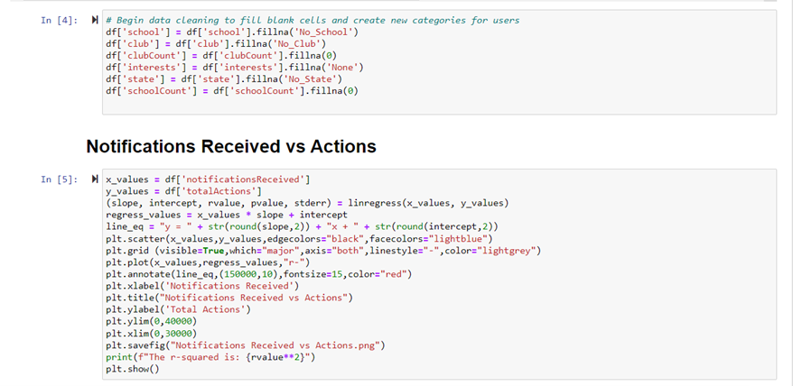
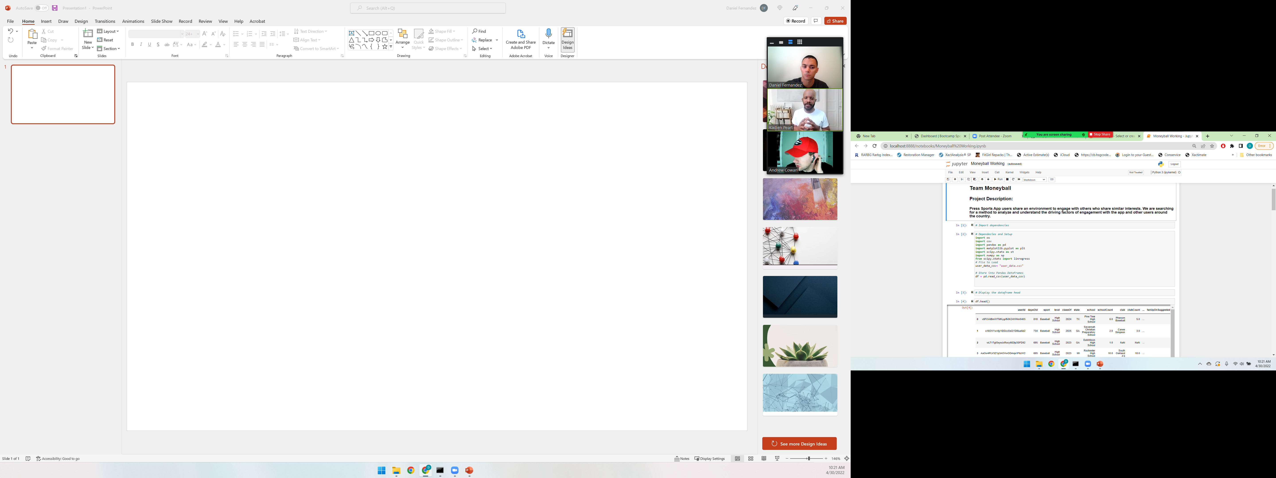
Python code

Slide 4
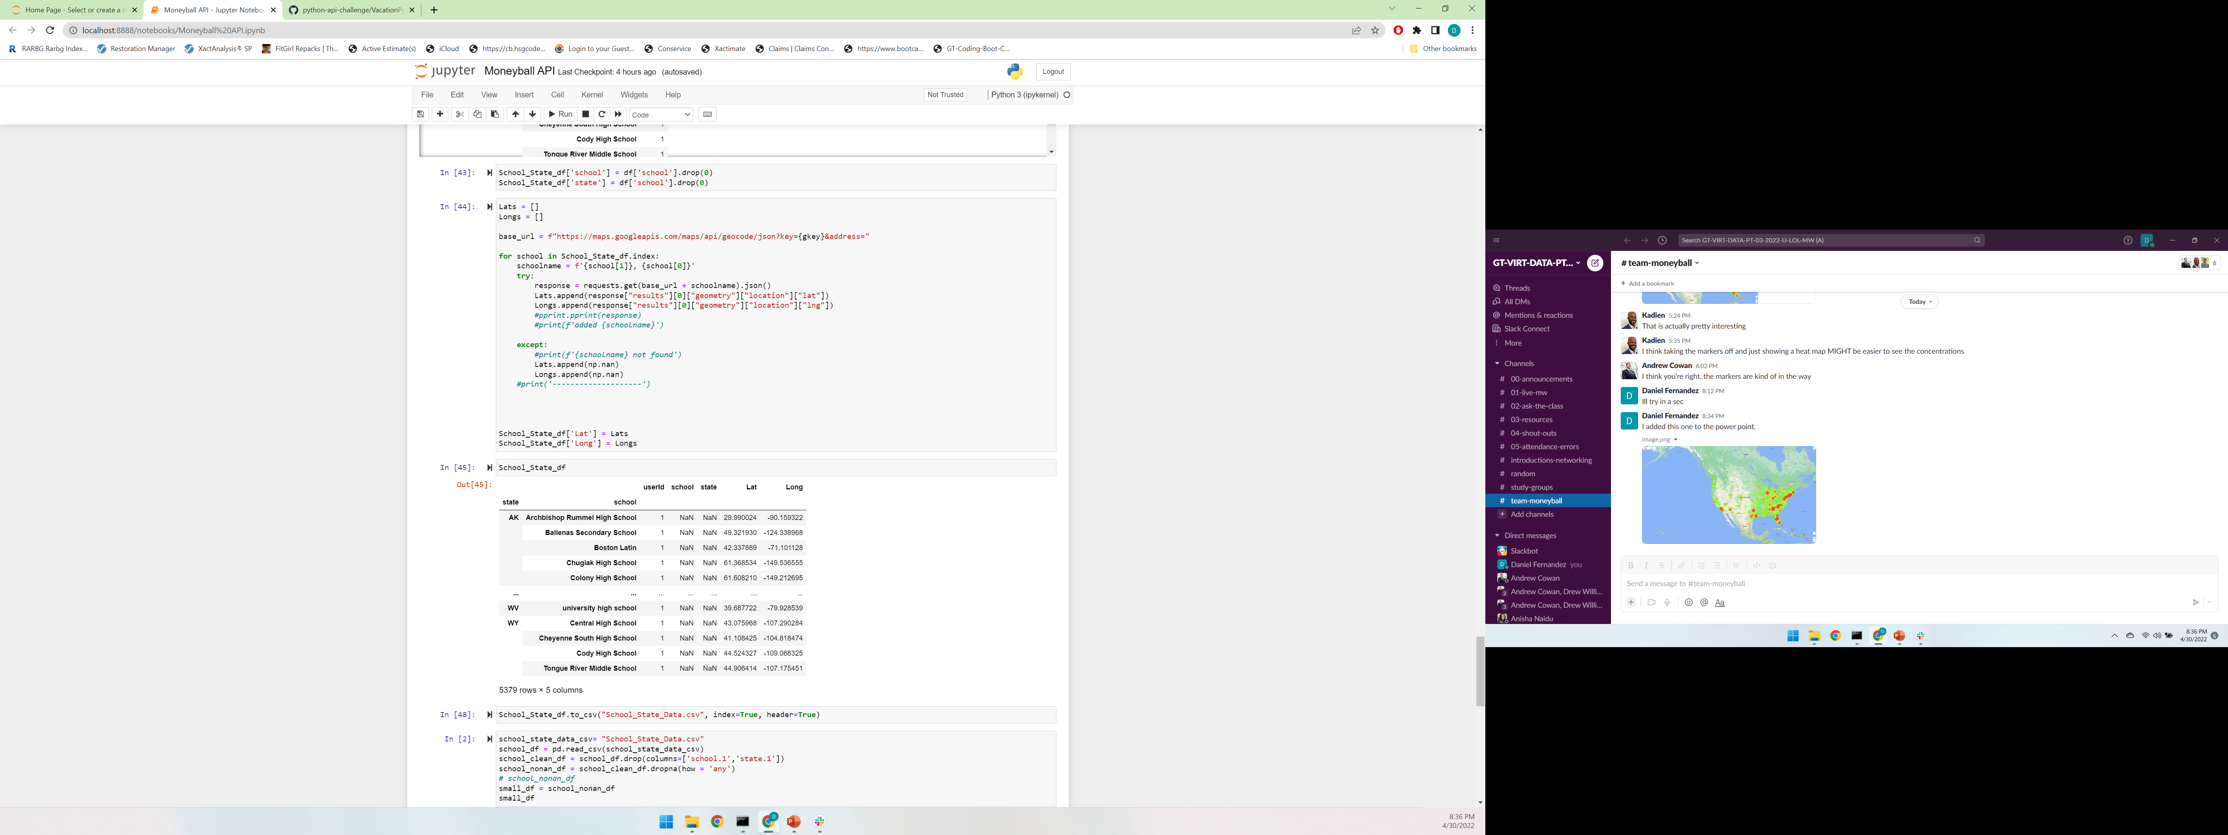
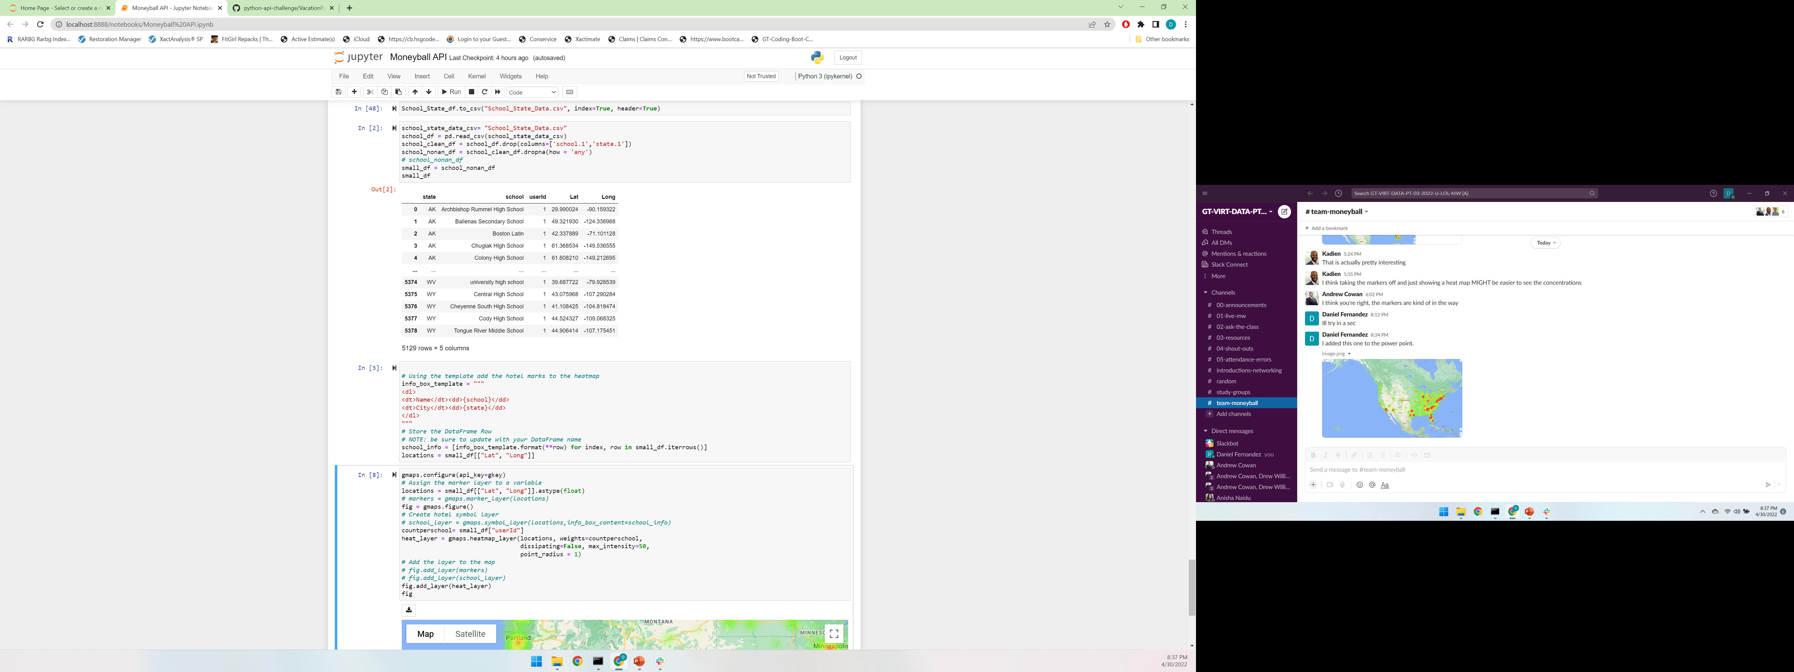
Python code

Slide 5
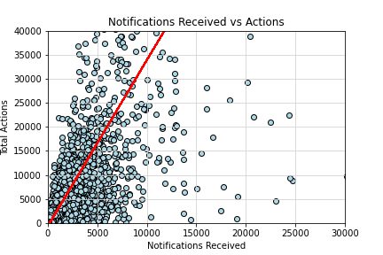
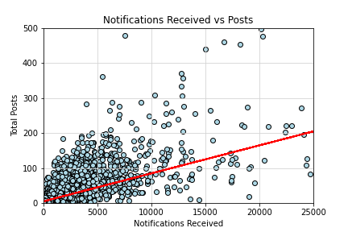
Test to check number of notifications received likes against number of posts and Actions
The r-squared is: 0.5839
The r-squared is: 0.5107

Slide 6
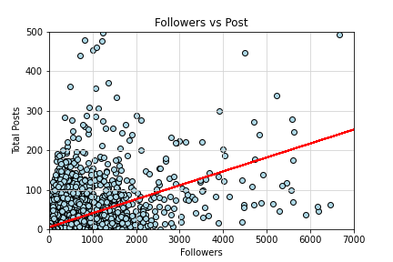
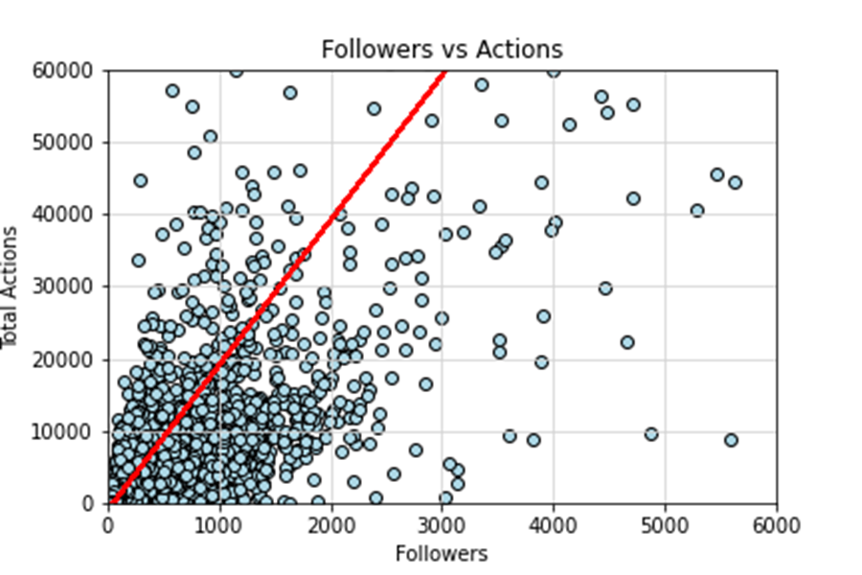
Test to check number of users followed against number of posts and Actions
The r-squared is: 0.3101
The r-squared is: 0.6137

Slide 7
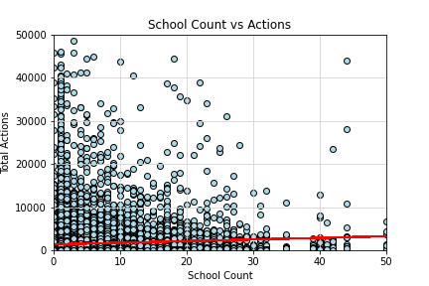
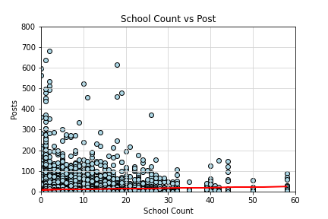
Test to check total number of students at school against number of posts and Actions
The r-squared is: 0.005
The r-squared is: 0.004

Slide 8


Findings

Slide 9

Business concept
Using our next-generation data architecture, we help organizations virtually manage agile workflows. We thrive because of our market knowledge and the great team behind our product.

Slide 10
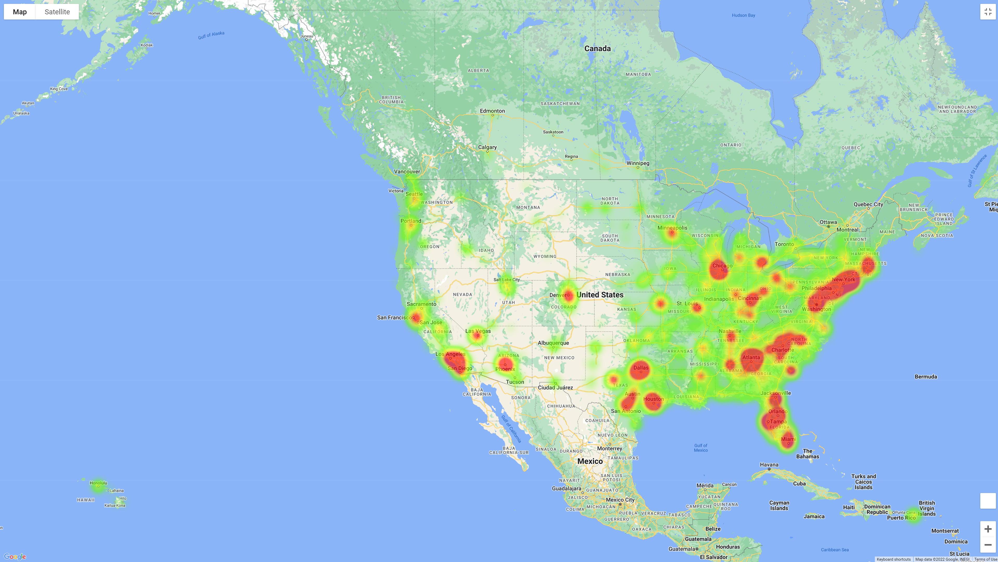
Heat Map of schools by state and Users Counts

Slide 11
Financials
Key metrics
Revenue by year
 | Clients | Orders | Gross revenue | Net revenue
20XX | 10 | 1100 | $10,000 | $7,000
20XX | 20 | 200 | $20,000 | $16,000
20XX | 30 | 300 | $30,000 | $25,000
20XX | 40 | 400 | $40,000 | $30,000

Slide 12
Financials table
 | YEAR 1 | YEAR 2 | YEAR 3 | DELTA
Income
Users | 50,000 | 400,000 | 1,600,000
Sales | 500,000 | 4,000,000 | 16,000,000
Average price per sale | 75 | 80 | 90
Revenue @ 15% | 5,625,000 | 48,000,000 | 216,000,000
Gross profit | 5,625,000 | 48,000,000 | 216,000,000
Expenses
Sales & marketing | 5,062,500 | 38,400,000 | 151,200,000 | 70%
Customer service | 1,687,500 | 9,600,000 | 21,600,000 | 10%
Product development | 562,500 | 2,400,000 | 10,800,000 | 5%
Research | 281,250 | 2,400,000 | 4,320,000 | 2%
Total expenses | 7,593,750 | 52,800,000 | 187,920,000

Slide 13

Risks and rewards
Risks
Rewards
New feature updates may not be popular with customers
Lack of staffing in key roles could delay product launch
Product will have more features which may require additional learning for customers
First on the market
Good publicity for the product so far, and we can build momentum from that scenario
Product testing with high-value clients have shown no issues

Slide 14

Key issues
Near term
Long term
Need funding in key roles
Lack of staffing will cause product delay
Need larger office space
Additional employees will require on-site office workspace

Slide 15
Thank you
Mirjam Nilsson​
206-555-0146
mirjam@contoso.com
www.contoso.com

